Slide 1
Citra | Pesan (karakter) | Pixel | Size (KB) | Waktu (detik) | Hasil
lena | 114 | 128 x 128 | 48 | 1 | Berhasil
 | 786 | 128 x 128 | 48 | 2.69 | Berhasil
 | 4415 | 128 x 128 | 48 | 20.36 | Berhasil
flowers | 114 | 512 x 320 | 480 | 1 | Berhasil
 | 786 | 512 x 320 | 480 | 2.7 | Berhasil
 | 8832 | 512 x 320 | 480 | 69.26 | Berhasil
candy | 114 | 1256 x 785 | 2820 | 1 | Berhasil
 | 786 | 1256 x 785 | 2820 | 2.71 | Berhasil
 | 13249 | 1256 x 785 | 2820 | 146.36 | Berhasil

Slide 2
Citra | Pesan (karakter) | Pixel | Size (KB) | Waktu (detik) | Hasil
lena | 114 | 128 x 128 | 48 | 1 | Berhasil
 | 786 | 128 x 128 | 48 | 3.6 | Berhasil
 | 4415 | 128 x 128 | 48 | 45.2 | Berhasil
flowers | 114 | 512 x 320 | 480 | 1 | Berhasil
 | 786 | 512 x 320 | 480 | 3.43 | Berhasil
 | 8832 | 512 x 320 | 480 | 141 | Berhasil
candy | 114 | 1256 x 785 | 2820 | 1 | Berhasil
 | 786 | 1256 x 785 | 2820 | 3.63 | Berhasil
 | 13249 | 1256 x 785 | 2820 | 325 | Berhasil

Slide 3
Citra | Pixel | Size (KB) | Kapasitas Karakter Maksimal Pesan
lena | 128 x 128 | 48 | 6096
flowers | 512 x 320 | 480 | 61320
candy | 1256 x 785 | 2820 | 369440

Slide 4
Citra | Bit | Pixel | Hasil
lena_gray | 8 | 512 x 512 | Gagal
lena | 24 | 128 x 128 | Berhasil
amelia | 32 | 1576 x 2364 | Berhasil

Slide 5
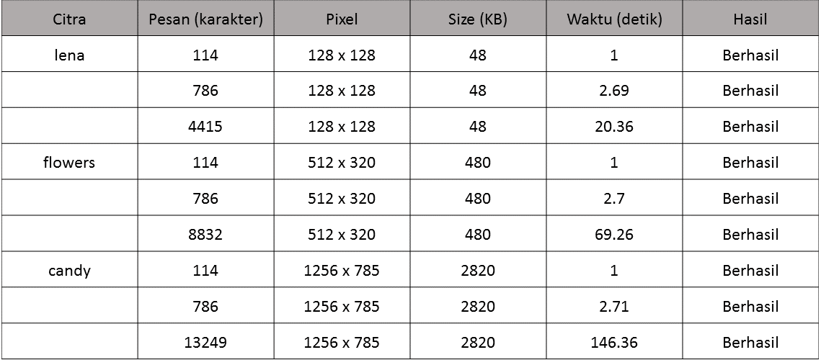

Slide 6


